Slide 1
ELEVATE LABS Data Analyst Internship Task 4: Creating Dashboards in Power BI / Tableau
Nazim Atakan Erdogan
Data Analyst Intern @ELEVATE LABS

Slide 2
Task Summary
Creating a dashboard for communicating with the business stakeholders.
Used filters
Included KPIs for through time, product segments etc.
Added cards for totals/summary
Applied consistent color theme
Created 3 dashboards

Slide 3
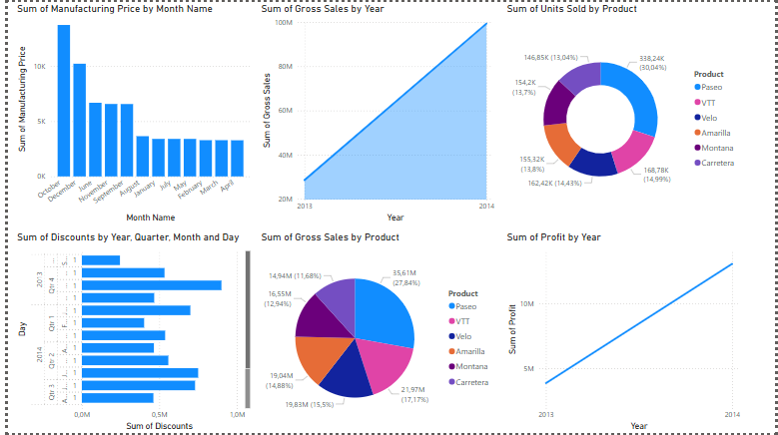
Dashboard 1 – Finance Dataset KPIs

Slide 4
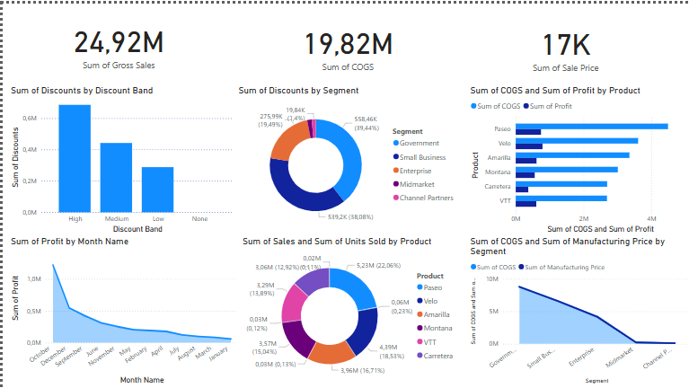
DASHBOARD 2 – KPIs in Germany
Here in this dashboard, the KPIs for Germany were investigated.
Sum of discounts by discount brand
Sum of discounts by segment
Sum of cogs of profit by product
Sum of profit by month
Sum of sales and sum of units sold by product
Sum of cogs and sum of manifucturing prices by segment

Slide 5
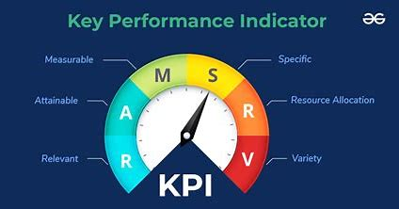
Key performance indicators which were identified
Sum of discounts by discount band
Sum of gross sales by year
Sum of manufacturing by year
Sum of gross sales by year
Sum of units sold per product
Sum of discounts per year
Sum of gross sales by product
Sum of profit by year

Slide 6
THANK YOU
NAZIM ATAKAN ERDOGAN
DA INTERN @ELEVATE LABS
Student at RWTH Aachen University, Germany

